Slide 1
AVERAGE EFFECT
Mean centred old vs new covariate
22 subjects

Slide 2
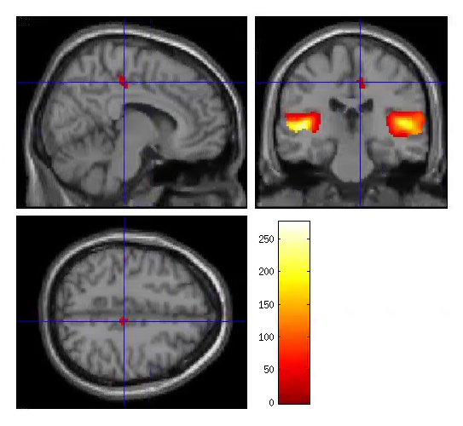
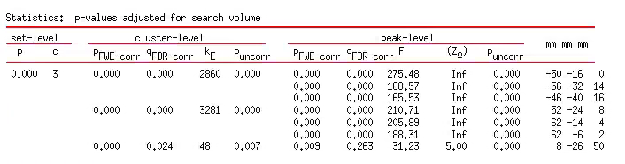
S1TBL_oldnew_mean_22subj
Extent threshold = 19
P<0.05 FWE cor
ROI1
ROI2
ROI3

Slide 3
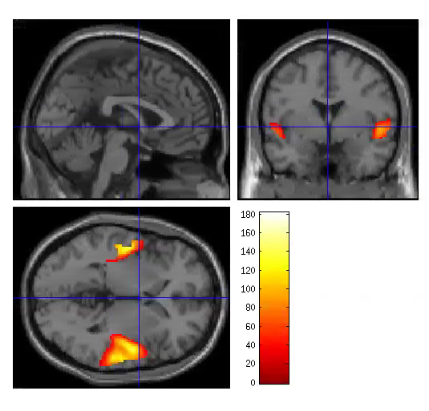
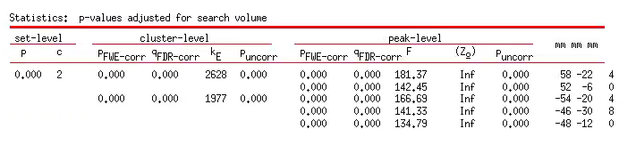
S2TBL_oldnew_mean_22subj
Extent threshold = 22
P<0.05 FWE cor
ROI1
ROI2

